Slide 1
Random Graphs – III Path Lengths
MA 653: Network Science
Instructor: Ashok Singh Sairam
ashok@iitg.ac.in

Slide 2

Review: Diameter and small-world effect
Diameter: maximum-minimum shortest distance between any two nodes
That is “the longest shortest path”
If the diameter of the random graph varies with n as $\ln{n}⇒$small-world effect

Slide 3
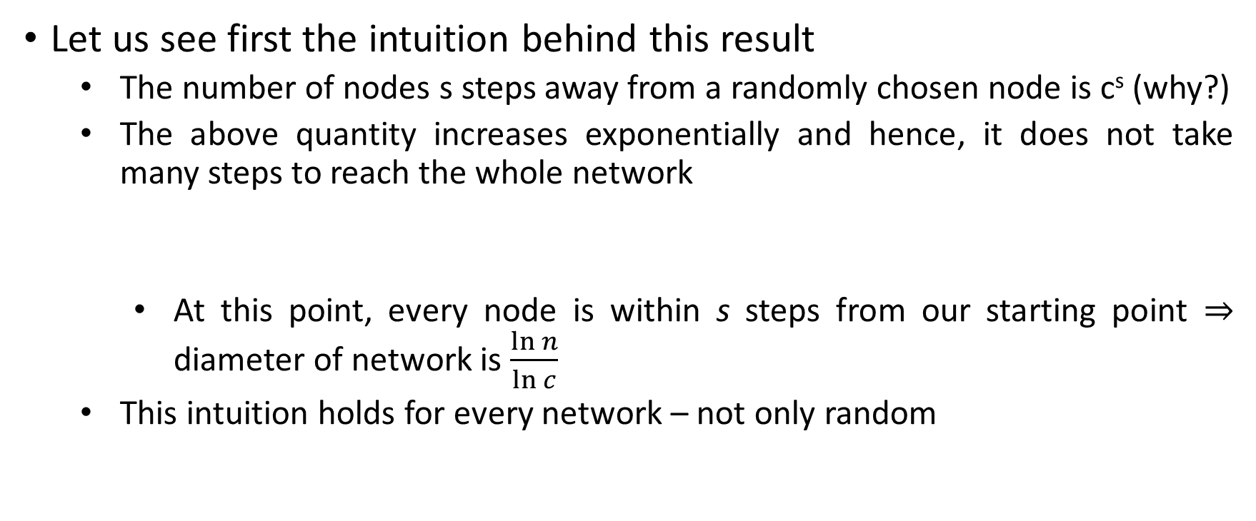
Path length: Intuitive idea
Let us see first the intuition behind this result
The number of nodes s steps away from a randomly chosen node is c^{s} (why?)
The above quantity increases exponentially and hence, it does not take many steps to reach the whole network
At this point, every node is within s steps from our starting point $⇒$ diameter of network is $\frac{\ln{n}}{\ln{c}}$
This intuition holds for every network – not only random

Slide 4
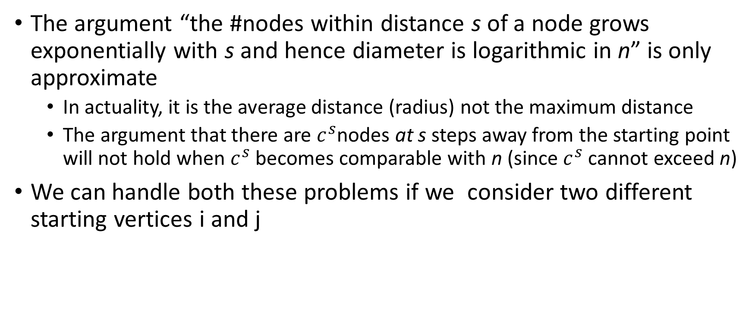
Fallacy of the intuition
The argument “the #nodes within distance s of a node grows exponentially with s and hence diameter is logarithmic in n” is only approximate
In actuality, it is the average distance (radius) not the maximum distance
The argument that there are $c^{s}$nodes at s steps away from the starting point will not hold when $c^{s}$ becomes comparable with n (since $c^{s}$ cannot exceed n)
We can handle both these problems if we consider two different starting vertices i and j

Slide 6
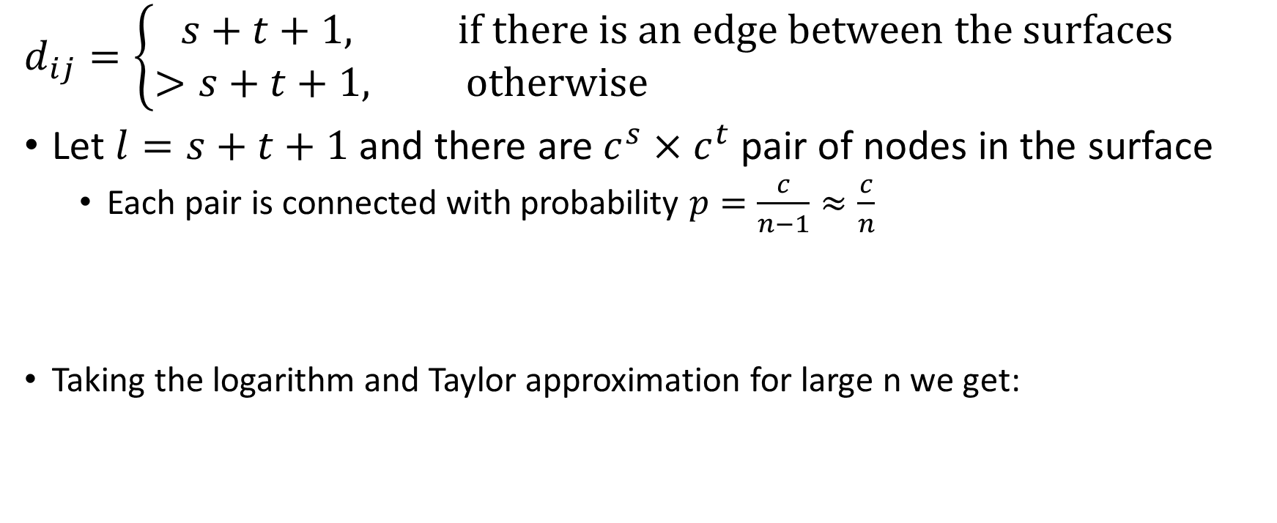
$$d_{ij}=\left\{\begin{aligned}s+t+1, if there is an edge between the surfaces \\ >s+t+1, otherwise \end{aligned}\right.$$
Let $l=s+t+1$ and there are $c^{s}×c^{t}$ pair of nodes in the surface
Each pair is connected with probability $p=\frac{c}{n−1}≈\frac{c}{n}$
Taking the logarithm and Taylor approximation for large n we get:

Slide 7
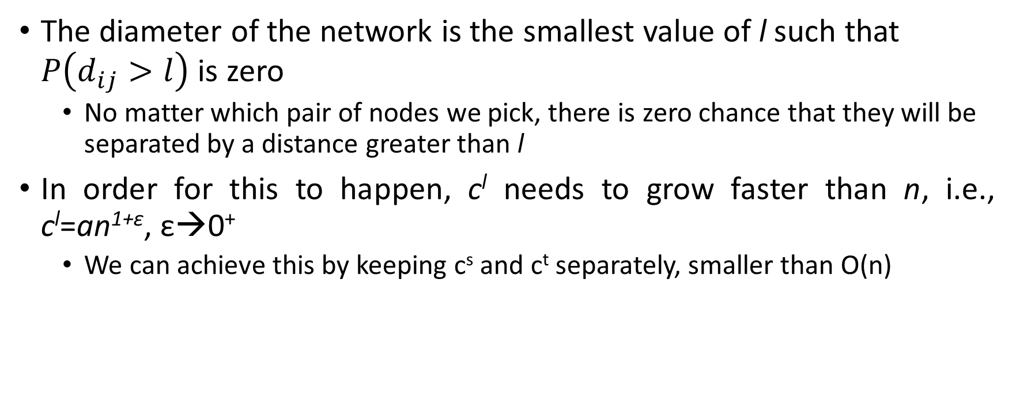
The diameter of the network is the smallest value of l such that $P\left(d_{ij}>l\right)$ is zero
No matter which pair of nodes we pick, there is zero chance that they will be separated by a distance greater than l
In order for this to happen, c^{l} needs to grow faster than n, i.e., c^{l}=an^{1+ε}, ε→0⁺
We can achieve this by keeping c^{s} and c^{t} separately, smaller than O(n)

Slide 8
Problems with random graph
Random Poisson graphs have been extensively studied
Easily tractable
small world effect
Major shortcomings make them inappropriate as a realistic network model
No transitivity or clustering, In Section 12.4 we saw at the clustering coefficient of a random graph is C = c/(n − 1), which tends to zero in the limit of large n
No correlation between the degrees of adjacent vertices
No community structure
Degree distribution differs from real networks

Slide 10
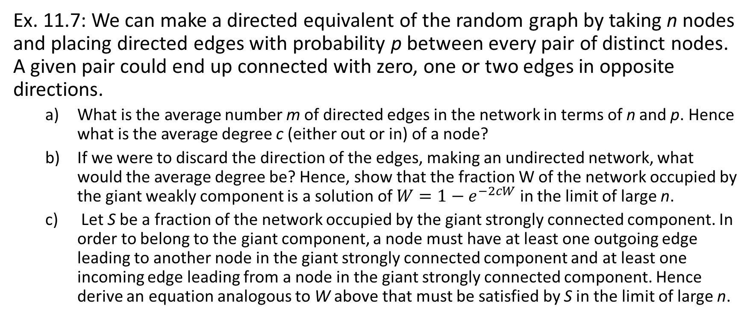
Exercise
Ex. 11.7: We can make a directed equivalent of the random graph by taking n nodes and placing directed edges with probability p between every pair of distinct nodes. A given pair could end up connected with zero, one or two edges in opposite directions.
What is the average number m of directed edges in the network in terms of n and p. Hence what is the average degree c (either out or in) of a node?
If we were to discard the direction of the edges, making an undirected network, what would the average degree be? Hence, show that the fraction W of the network occupied by the giant weakly component is a solution of $W=1−e^{−2cW}$ in the limit of large n.
Let S be a fraction of the network occupied by the giant strongly connected component. In order to belong to the giant component, a node must have at least one outgoing edge leading to another node in the giant strongly connected component and at least one incoming edge leading from a node in the giant strongly connected component. Hence derive an equation analogous to W above that must be satisfied by S in the limit of large n.

